Slide 1
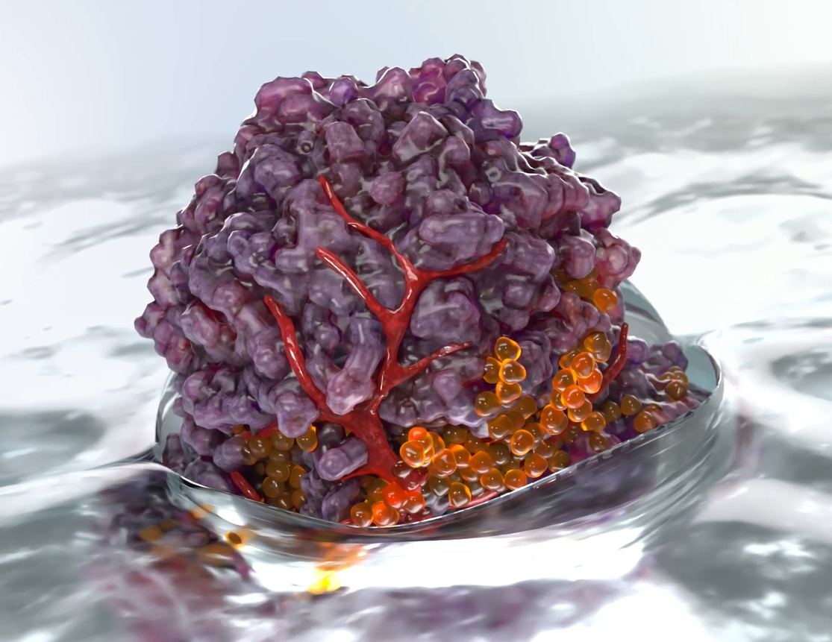
Ex Vivo Human Tumor Tissues can De-Risk Pre-Clinical Immunotherapy Development
Tessa DesRochers, PhD
January 25, 2023

Slide 2
Agenda and Goals
Description of Kiyatec’s technology and testing platforms
  Tissue resources
  Tumor spheroids
  Microtumors
  Applications for Drug Response
  Clinical correlations
A Look at T-cell Persistence and Activity in Kiyatec’s Ex Vivo Cultures
  How long do immune cells remain in the cultures
  Are they active and functional?
Utilization of Kiyatec’s platforms for checkpoint inhibitors, bispecifics, and cellular therapies.

Slide 3
Kiyatec’s Technology

Slide 4
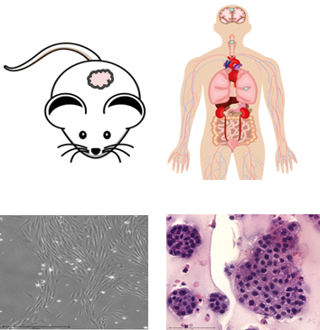
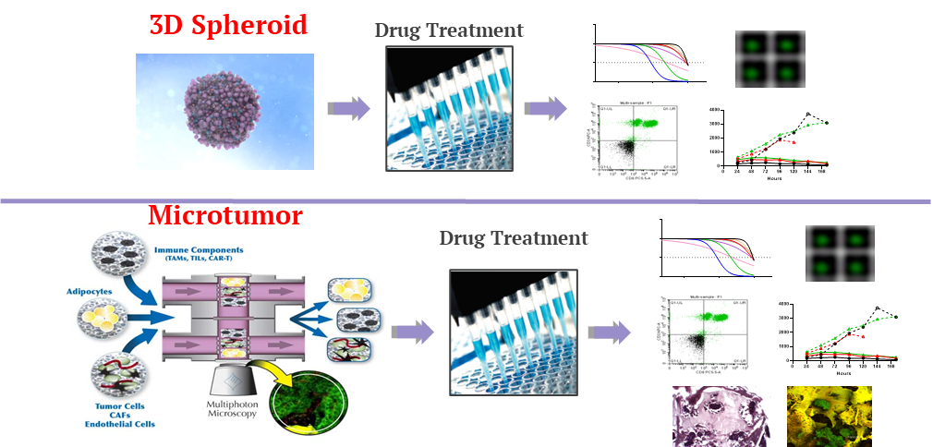
KIYA-PREDICT™ multiple assay platforms for solid tumors
Inputs : Fresh / Frozen Primary Human Tissue, PDX, Cell Lines, Organoids
Kiyatec’s assay platforms:
Spheroid – Microtumor
Multiple platforms facilitate screening animal models ex vivo in 3D prior to initiating in vivo and complex immune biology studies
Using validated, correlative models, Kiyatec accelerates the drug development process, saving time and money

Slide 5
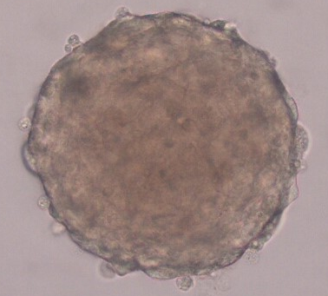
KIYA-PREDICT™ multiple assay platforms for solid tumors
Inputs : Fresh / Frozen Primary Human Tissue, PDX, Cell Lines, Organoids

Slide 6
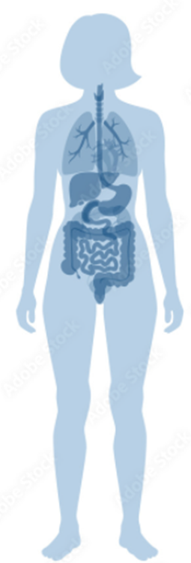

KIYA-PREDICT™ multiple assay platforms for solid tumors
Inputs : Fresh / Frozen Primary Human Tissue, PDX, Cell Lines, Organoids
Primary Tissue Organoid Models
PDX-based Organoid Models
CRC
Prostate
Breast
HGG
Lung
Breast
CRC
Ovarian
Bladder
Many of our primary tissue-based organoids have matched autologous T-cells banked for recombination

Slide 7
KIYA-PREDICT™ multiple assay platforms for solid tumors
Inputs : Fresh / Frozen Primary Human Tissue, PDX, Cell Lines, Organoids
Collaborative agreement in place with XenoSTART allows easy ex vivo testing of their PDX tissues in Kiyatec’s testing platforms followed by a seamless transition to in vivo studies.
By adding allogenic human immune cells to the ex vivo testing process, therapeutics such as checkpoint inhibitors, bi-specifics, and cellular therapies can all be tested without having to make expensive humanized mice

Slide 8
KIYA-PREDICT™ multiple assay platforms for solid tumors
Inputs : Fresh / Frozen Primary Human Tissue, PDX, Cell Lines, Organoids
Processed and tested over 1500 primary tissues with a take-rate >90%
Available bio-bank of ovarian, high-grade glioma, breast, and other primary tumors
Shipping protocols to receive fresh tissue across the United States and modifications for receipt from Europe
Active network to find tumor types upon request

Slide 9
KIYA-PREDICT™ multiple assay platforms for solid tumors
Inputs : Fresh / Frozen Primary Human Tissue, PDX, Cell Lines, Organoids
Kiyatec’s assay platforms:
Spheroid
Data readouts < 14 days
Multiple drug doses and combinations
Readout examples include:
    Cell viability analysis
    Biomarker analysis
    Spheroid characterization via IHC, Flow, DNA / RNA etc.
I/O Readouts include:
  Immune cell activation & expansion
    Flow cytometry
    Imaging
  Tumor specific viability over time
  Secreted factors over time

Slide 10
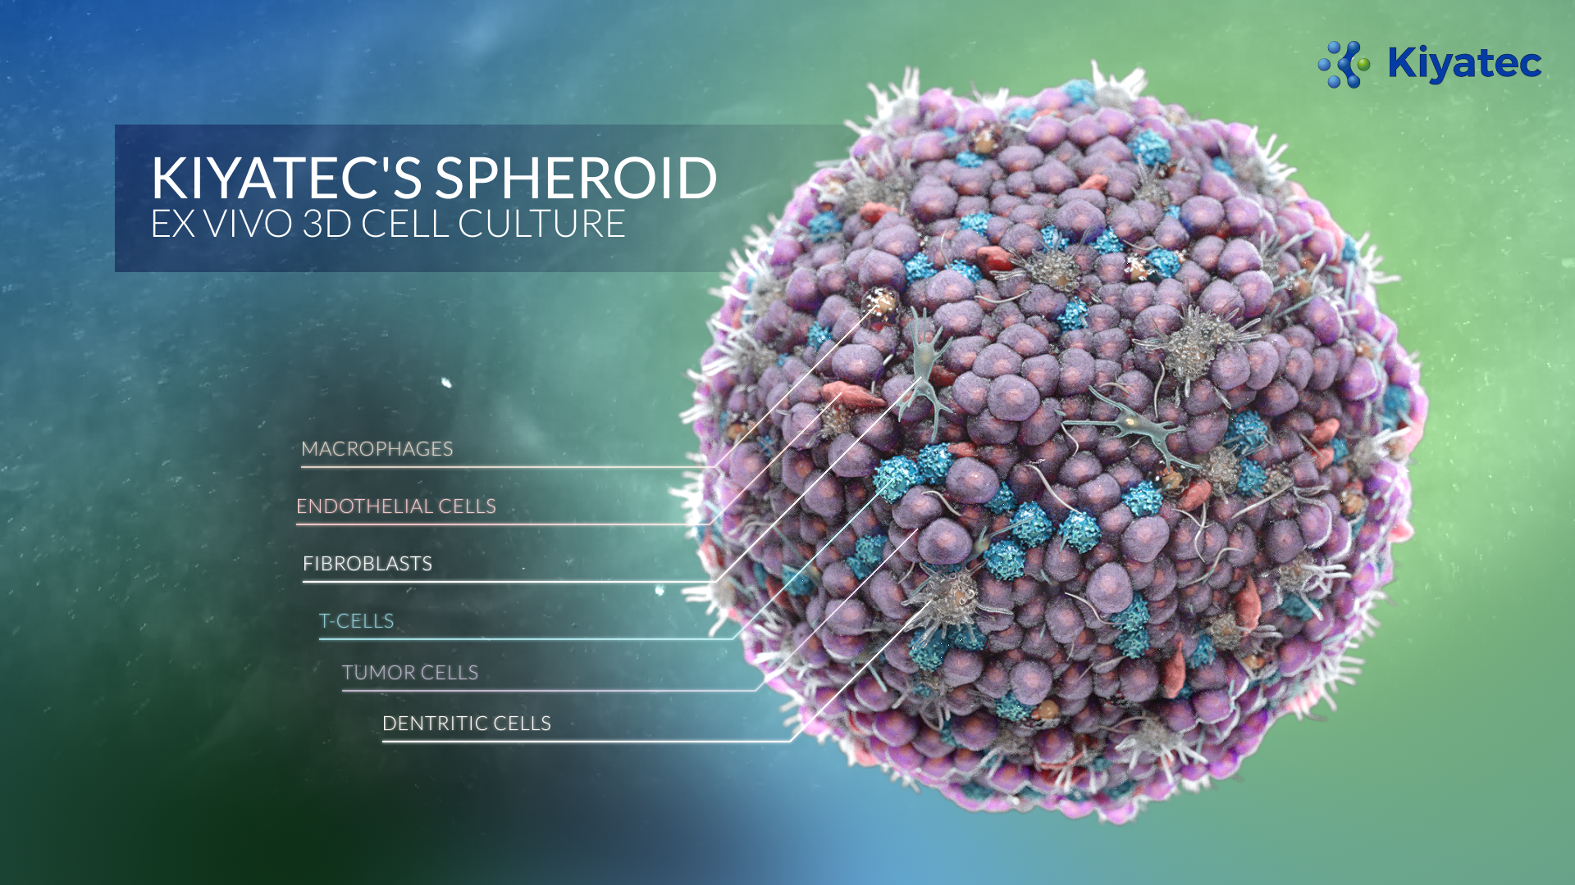
Kiyatec’s spheroids contain all cells present in the primary tumor

Slide 11
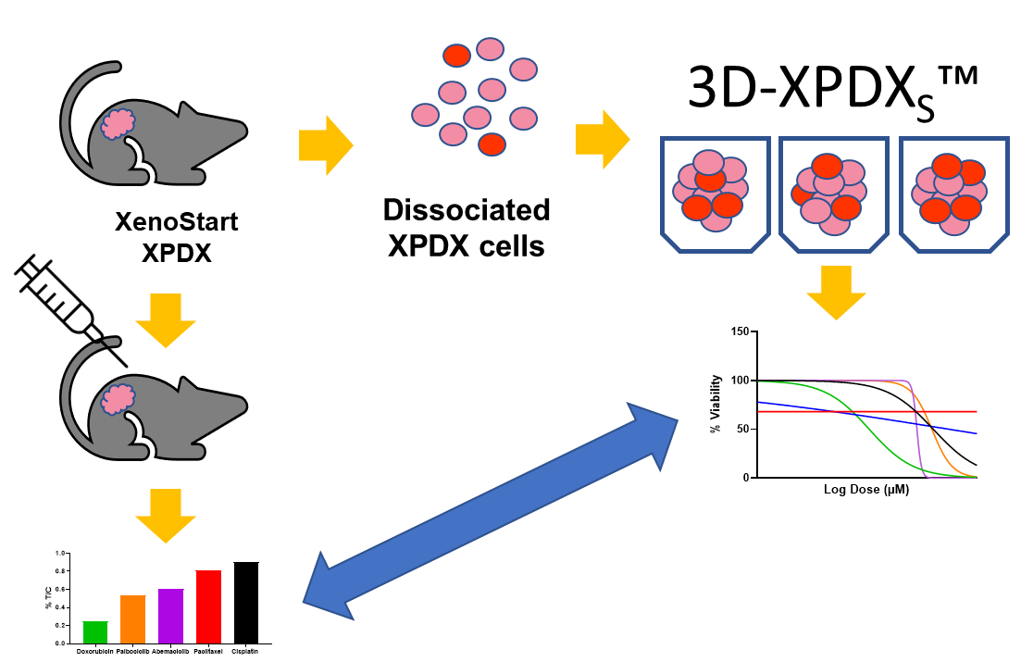

In Vivo Model Selection
Kiyatec has been performing ex vivo PDX screening for model selection for almost 10 years.
Dozens of models can be screened across dozens of compounds quicker and cheaper than in vivo

Slide 12
In Vivo Model Selection
Ex Vivo Drug Response Curves
In Vivo Treatment/Control (%T/C)

Slide 13
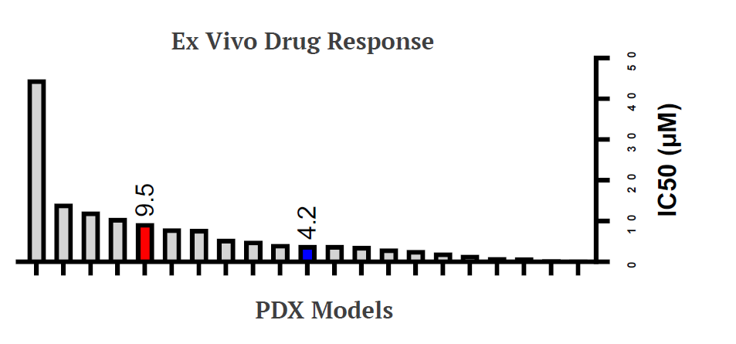
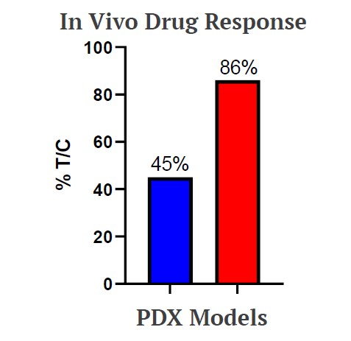
PDX tissues can be utilized to triage in vivo study selection
*Red = drug resistant model developed from the blue model. The ex vivo data replicates the in vivo acquired resistance
The KIYA-predict platform lets you to rank order one drug across multiple PDX models allowing you to identify responders and non-responders, saving time and money on model selection.

Slide 14
Published Correlation with Clinical Outcomes
Ovarian Cancer Carboplatin/Paclitaxel
High-Grade Glioma
Temozolomide
 | n, total | Test Responders PFS, months | Test Non-Responders PFS, months | p-value (Wilcoxon)
PFS (median) | 35 | Undefined (n=26) | 9 (n=9) | 0.01
 | n, total | Test Responders PFS, months | Test Non-Responders PFS, months | p-value (Wilcoxon)
PFS (median) | 42 | 9.1 (n=9) | 5.4 (n=33) | 0.039

Slide 15
KIYA-PREDICT™ multiple assay platforms for solid tumors
Inputs : Fresh / Frozen Primary Human Tissue, PDX, Cell Lines, Organoids
Kiyatec’s assay platforms:
Microtumor
Data readouts > 3 months
Multiple drug doses and combinations
Timed on/off drug exposure
Sequential dosing
Readout examples include:
    Cell viability analysis
    Biomarker analysis
    Imaging
    IHC, Flow, DNA / RNA etc.
I/O Readouts include:
  Immune cell activation & expansion
    Flow cytometry
    Imaging
  Immune cell recruitment / infiltration
    Flow cytometry
    Imaging
  Tumor specific viability over time
  Secreted factors over time
15

Slide 16
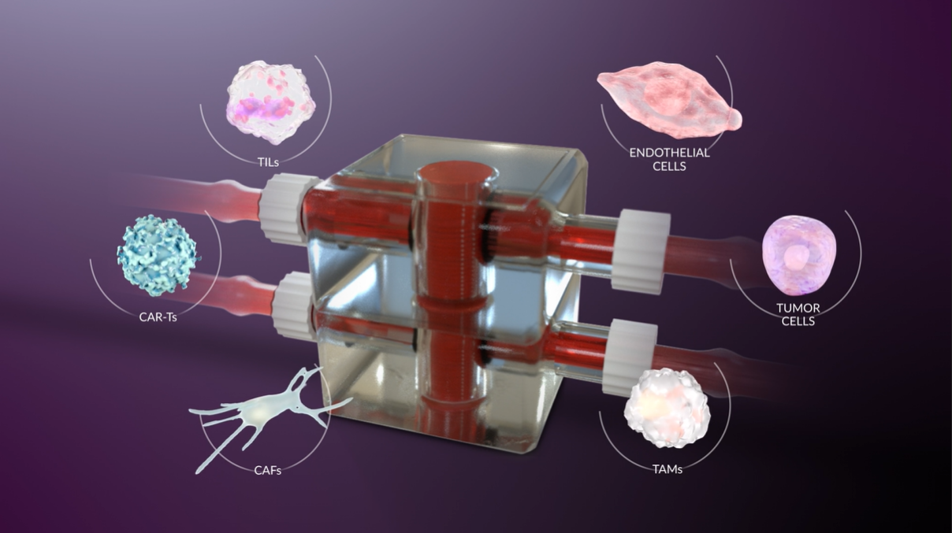
Kiyatec’s microtumors allow the compartmentalization of cell types

Slide 17
Microtumors can be imaged with Multiphoton Microscopy Over Time
2 Weeks
3 Weeks
*
*

Slide 18
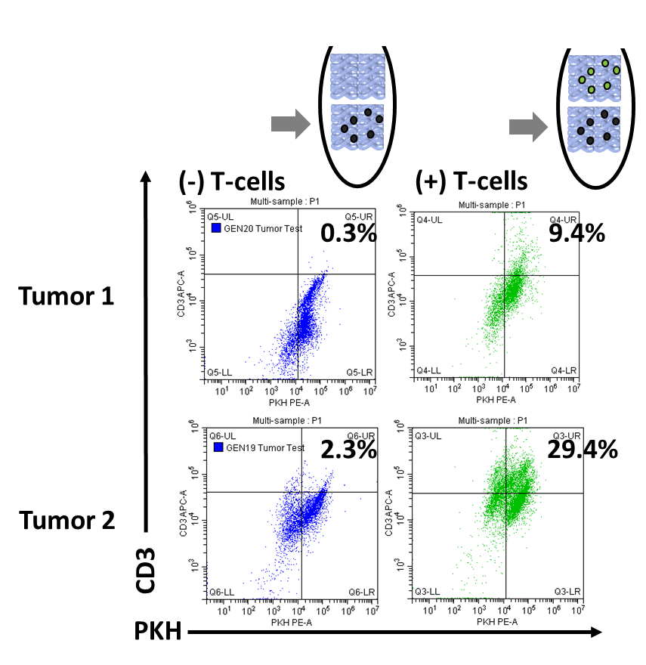
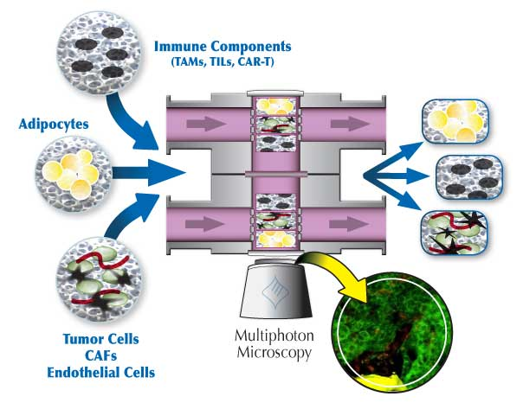
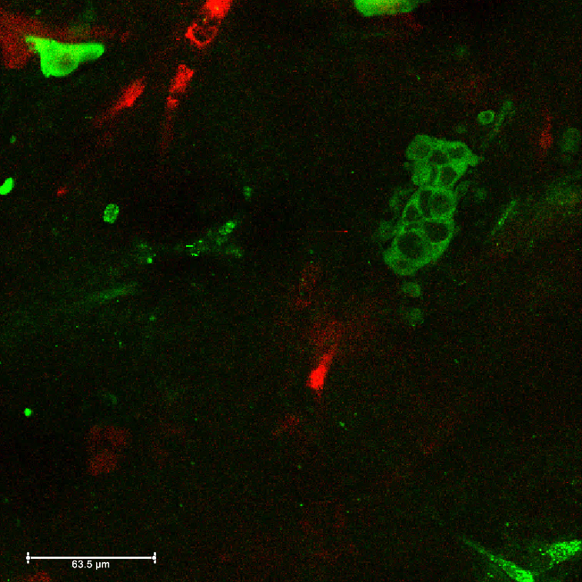
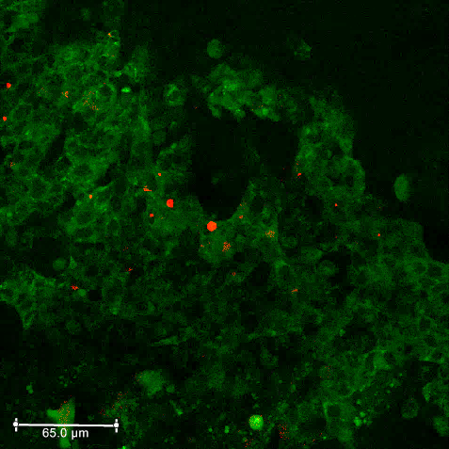
Microtumors Can Be Used to Track Immune Cell Migration and Infiltration
Detection method
Flow cytometry
Detection method
Multiphoton Microscopy
Day 7
Day 14
When seeded in ECM in a separate compartment,
T-cells migrate into the Tumor cell compartment over the course of 7 days in a patient-specific manner
When seeded in ECM in a separate compartment, M2 macrophages migrate into the tumor cell compartment over the course of 14 days in perfusion culture

Slide 19
T-cell Persistence & Activity

Slide 20
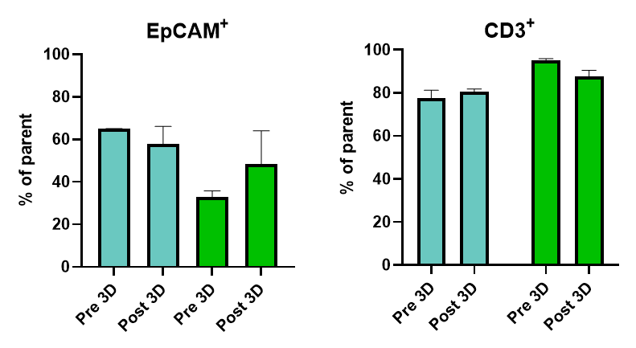
Do Immune Cells Remain in the Cultures?

Slide 21
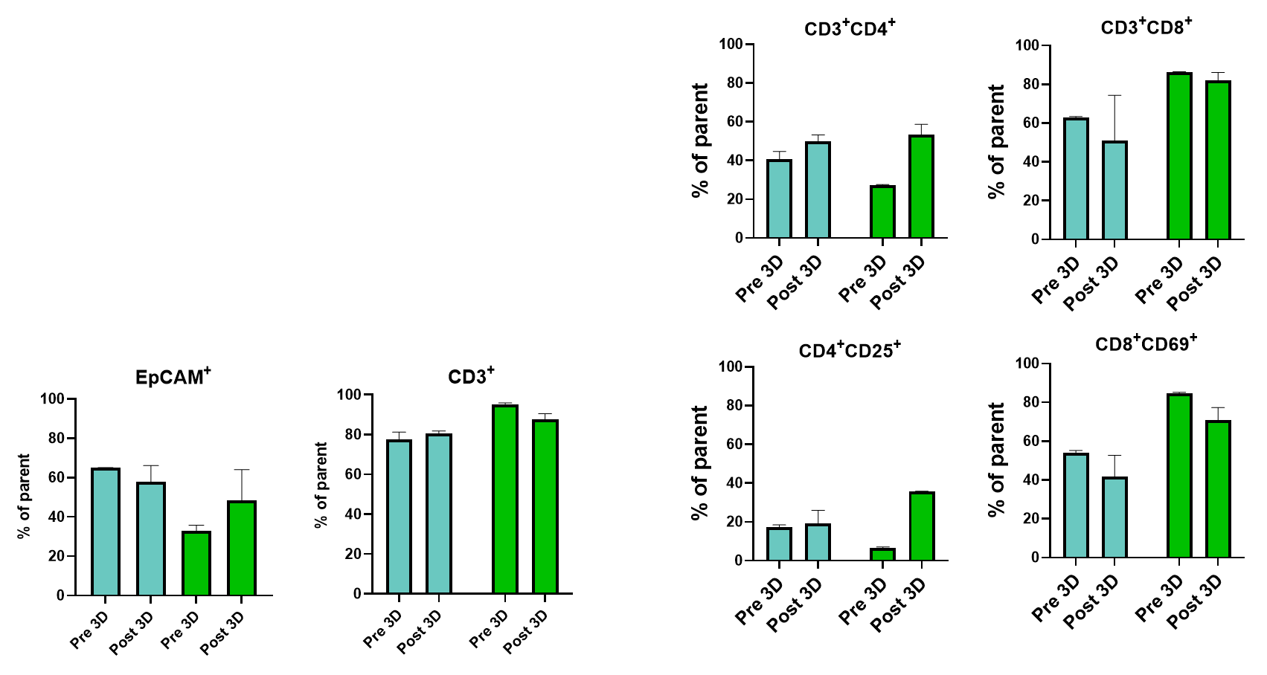
Are the Immune Cells Active in the Cultures?

Slide 22
Why do We have a T-cell persistence assay?
Due to the variability of personalized cellular immunotherapies, verification of T-cell function would facilitate selection of the most desirable product for clinical use
T-cell anti-tumor success depends on how long the T-cells exist after infusion into the host (persistence).
In vivo, T-cells encounter large tumor burdens that require multiple rounds of killing.

Slide 23
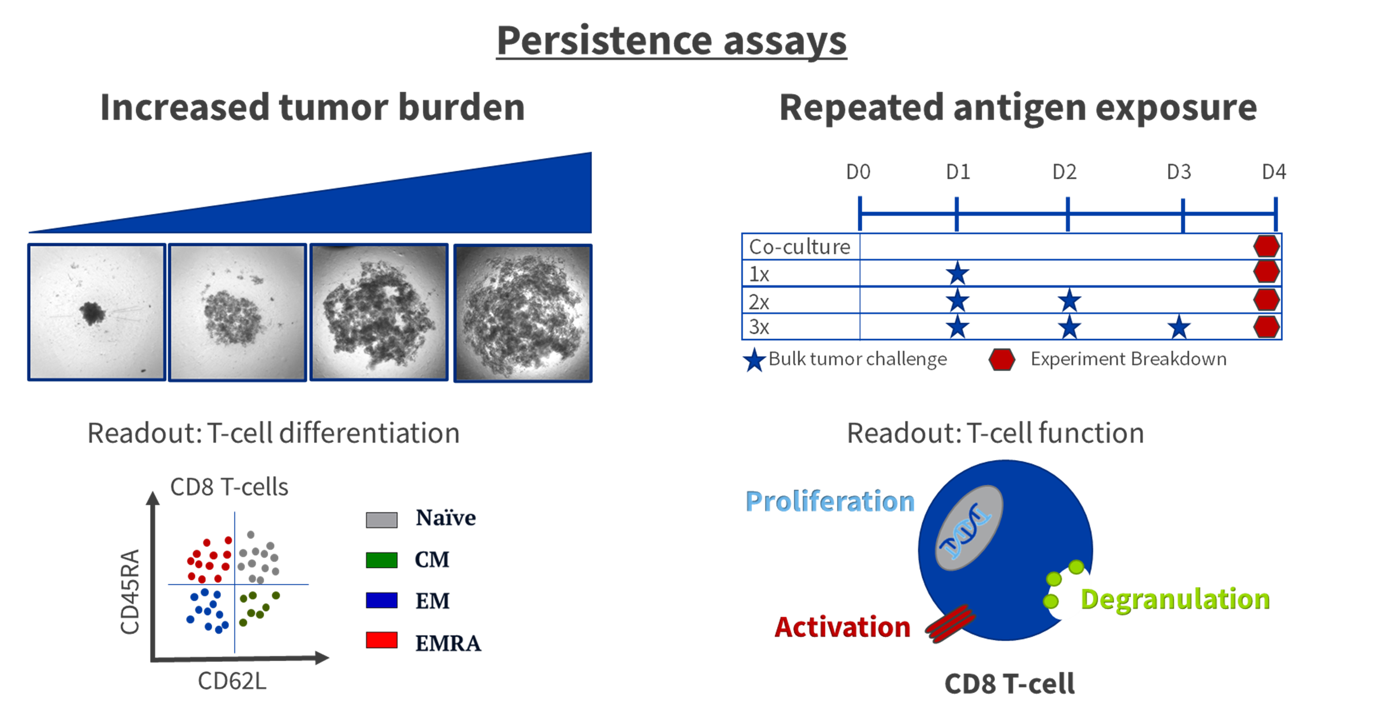
T-cell persistence assays

Slide 24
Models
Patient 4
  Newly diagnosed
  Histology: mixed serous and endometroid
  Location: right fallopian tube and left ovary
  Grade: high
  Stage IIIC
  Ex vivo pembrolizumab responder
Patient 5
  Post-neoadjuvant
  Histology: serous
  Location: omentum
  Grade: high
  Stage: IIIC
  Ex vivo pembrolizumab non-responder
Sample Characteristics | Patient 4 | Patient 5
Bulk CD45 | 92.5% | 71.0%
Bulk EpCAM | 4.2% | 10.5%
Bulk other cells | Not Detected | 13.5%
Bulk viability | 63.9% (ave N=4) | 74.7% (ave N=4)

Slide 25
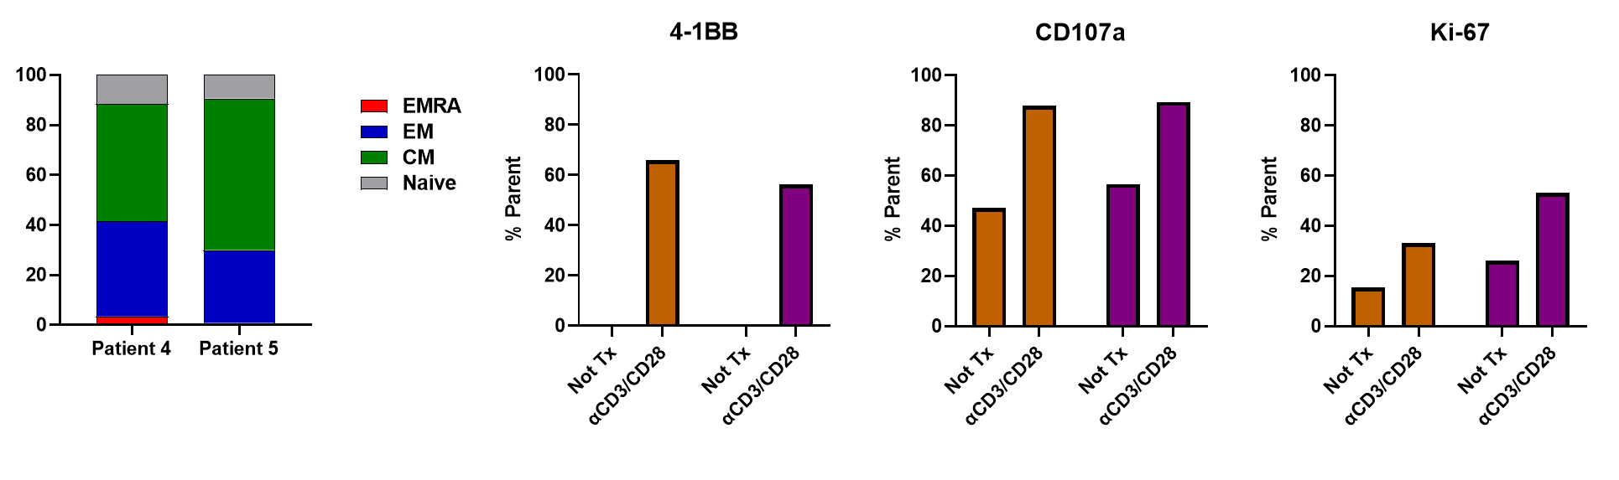
Function of exTILs
Patient 4 and Patient 5 exTILs have similar T-cell subsets proportions
Patient 4 and Patient 5 exTILs have similar T-cell baseline markers of activation and respond to artificial stimulation with similar increases in response

Slide 26
Increased tumor burden assay
Patient 4
Patient 5
Naïve
CM
EM
% Parent
% Parent
EMRA
Input
Input
Input
Input
Input
Input
Input
Input
Both patient exTILs shift towards a more effector phenotype following high tumor burden, but Patient 5 was more susceptible and therefore potentially less persistent
26

Slide 27
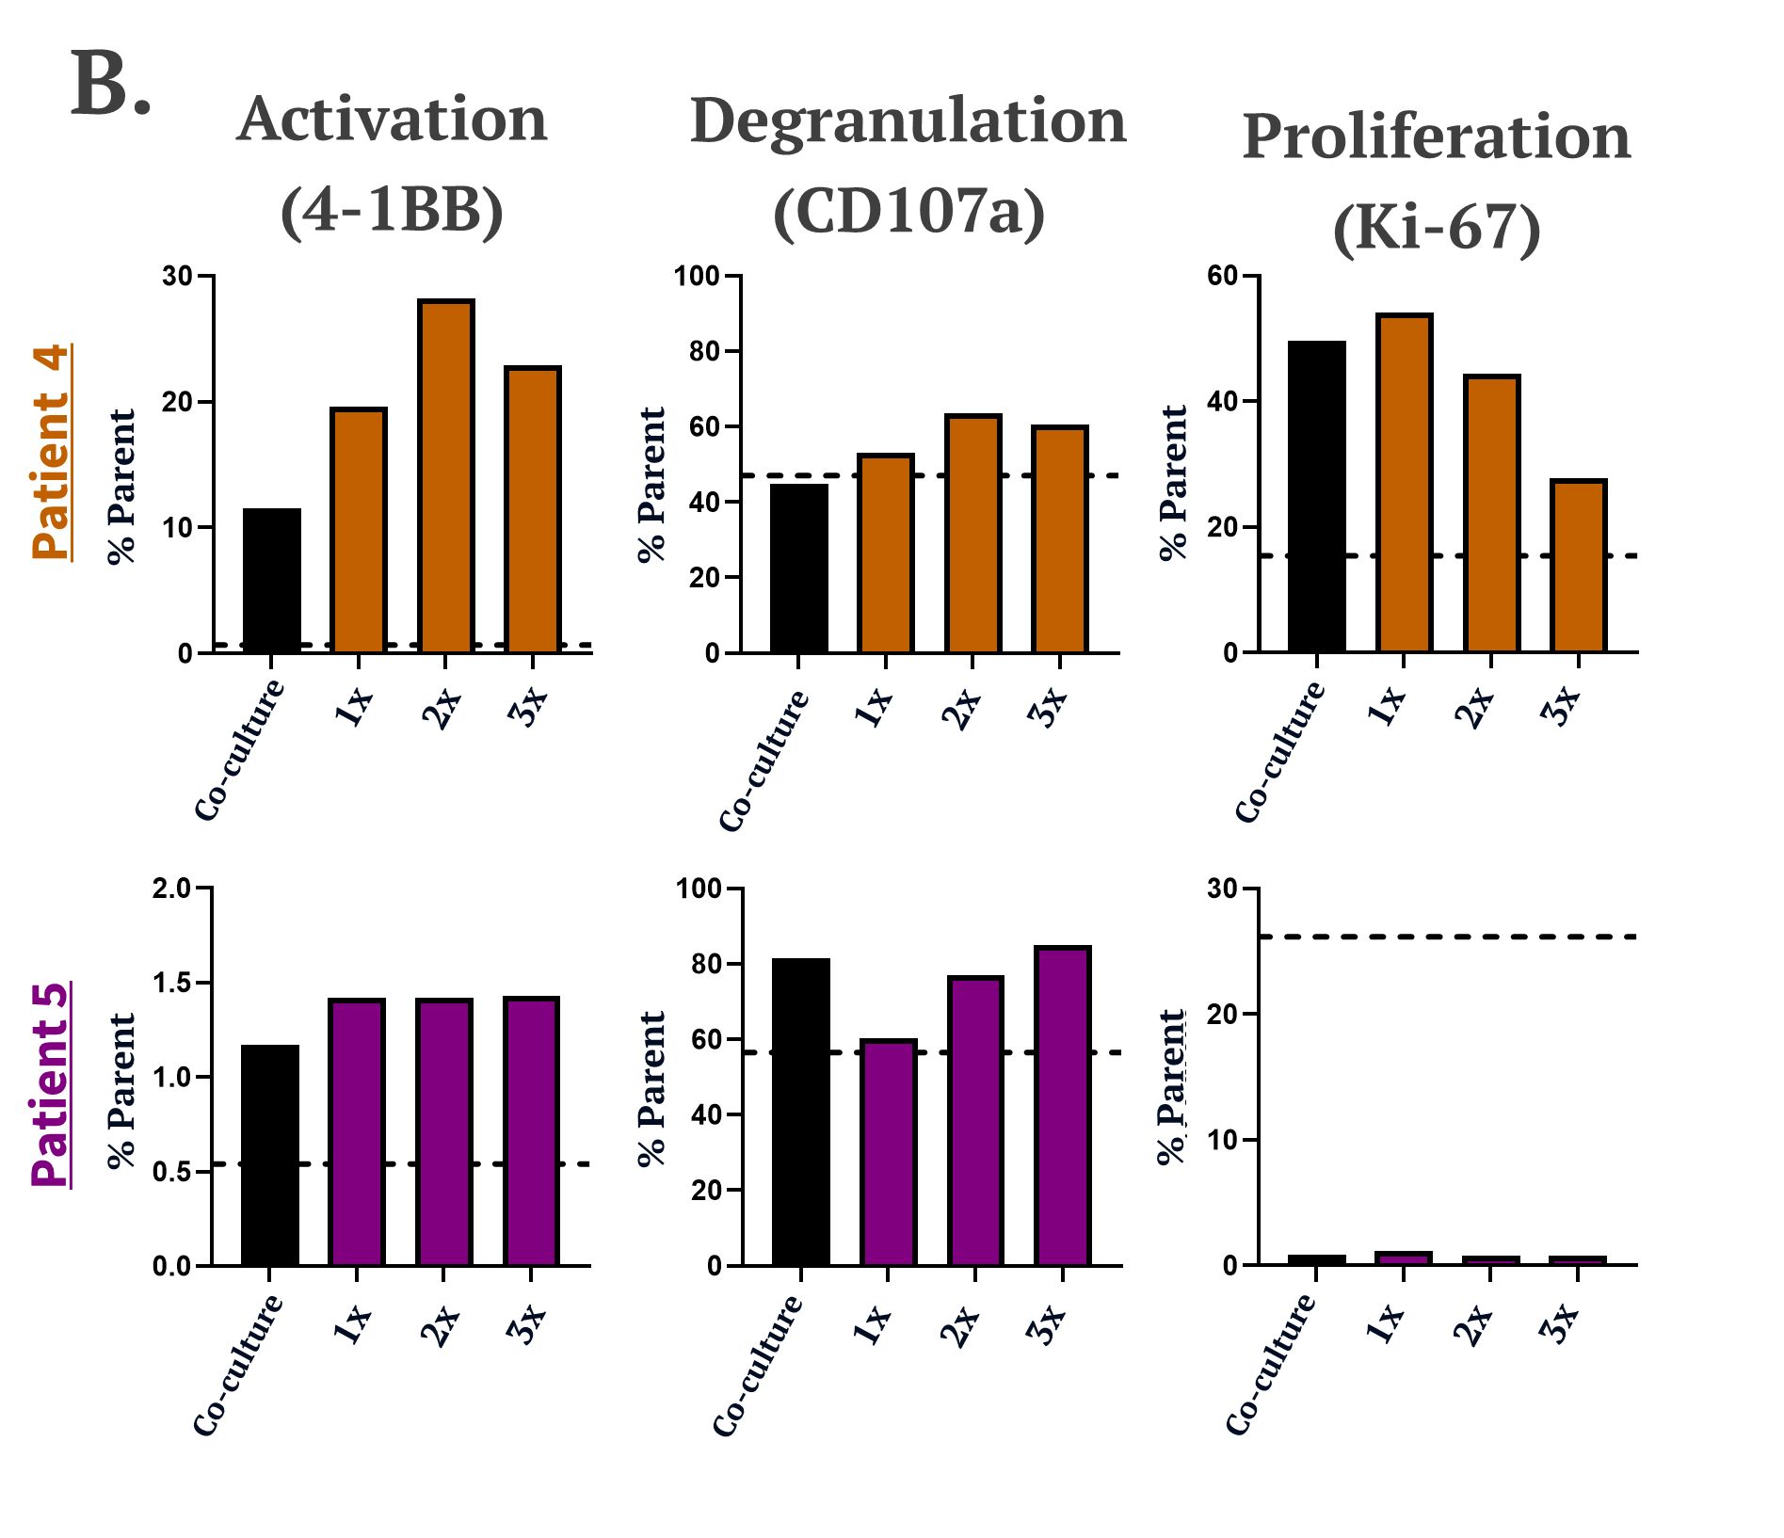
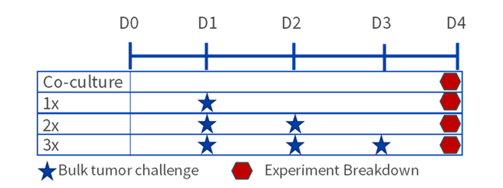
Repeated antigen exposure assay
Patient specific TME drives T-cell persistence!
Functionally similar expanded CD8+ TILs demonstrate differences in persistence in patient-specific autologous tumor microenvironment. TILs were co-cultured with autologous tumor cells and were rechallenged once (1x), twice (2x), or three times (3x). Markers were evaluated after four days. The dotted line indicates TIL input alone as a reference.

Slide 28
Utility – Checkpoint Inhibitors

Slide 29
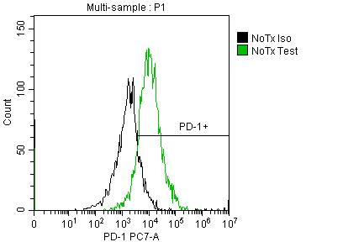
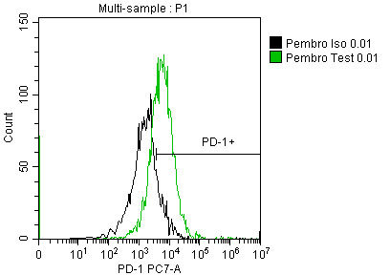
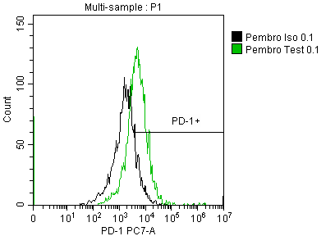
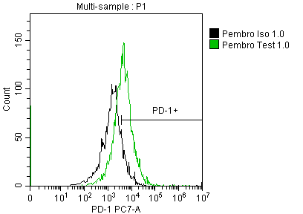
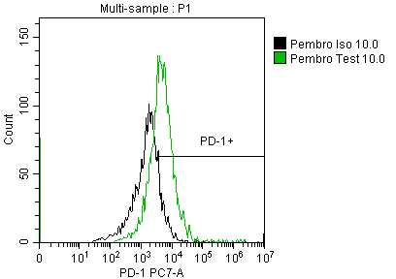
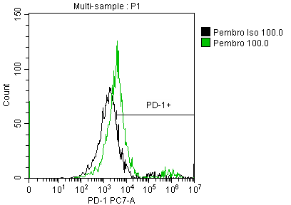
Ex Vivo Checkpoint Inhibitor Testing
No Tx
0.01 µg/mL
0.1 µg/mL
1.0 µg/mL
10 µg/mL
100 µg/mL
PD-1⁺
70.4%
PD-1⁺
51.3%
PD-1⁺
42.4%
PD-1⁺
40.9%
PD-1⁺
43.7%
PD-1⁺
26.3%
Black = Isotype control Green = PD-1
Pembrolizumab Occupancy
29

Slide 30
Ex Vivo Checkpoint Inhibitor Testing
No Tx
0.01 µg/mL
0.1 µg/mL
1.0 µg/mL
10 µg/mL
100 µg/mL
PD-1⁺
70.4%
PD-1⁺
51.3%
PD-1⁺
42.4%
PD-1⁺
40.9%
PD-1⁺
43.7%
PD-1⁺
26.3%
Black = Isotype control Green = PD-1
Pembrolizumab Occupancy
Pembrolizumab Induced Activation
30

Slide 31
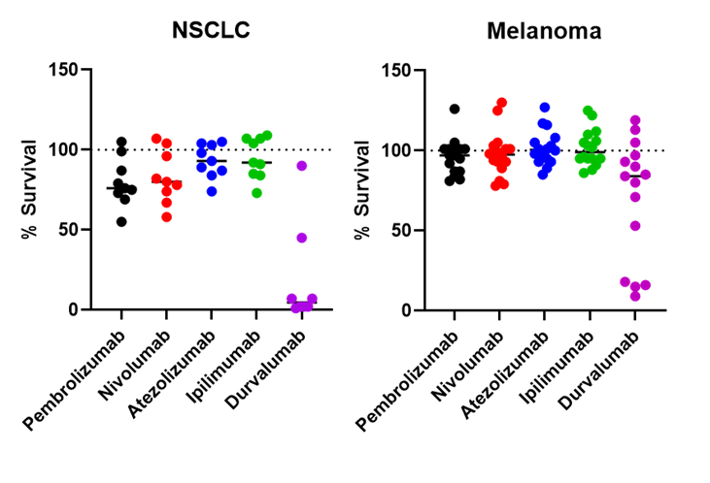
Ex Vivo Checkpoint Inhibitor Testing
No Tx
0.01 µg/mL
0.1 µg/mL
1.0 µg/mL
10 µg/mL
100 µg/mL
PD-1⁺
70.4%
PD-1⁺
51.3%
PD-1⁺
42.4%
PD-1⁺
40.9%
PD-1⁺
43.7%
PD-1⁺
26.3%
Black = Isotype control Green = PD-1
Pembrolizumab Occupancy
Pembrolizumab Induced Activation
Checkpoint Inhibitor Induced Cytotoxicity
31

Slide 32
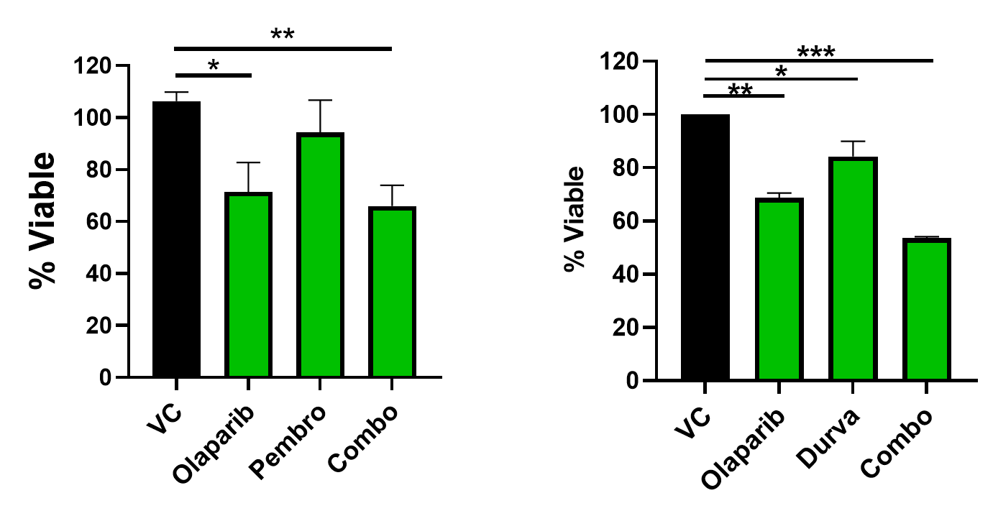
Combination Studies
Combination studies may be performed with standard chemotherapies, checkpoint inhibitors + chemotherapy, cellular therapies + chemotherapy, ADCs + chemotherapy, etc.

Slide 33

Checkpoint Inhibitor Induced Reinvigoration
Anti-PD-1/PD-L1 checkpoint inhibitors are thought to be the spark needed to reinvigorate TILs. We test for this activity directly using ex vivo cultures.
Reinvigoration
Resect tumor
3D spheroid culture
+/- anti-PD-1
We can measure persistence-like phenotypes at this stage of patient response profiling via induction of T-cell proliferation, change in T-cell memory/effector subtypes, as well as measuring secretion of chemokines known to recruit new T-cells (clonal replacement) to the TME
Do immune checkpoint inhibitors stimulate T-cell activation?
Persistence?
T-cell maturation & proliferation
Chemokine secretion

Slide 34
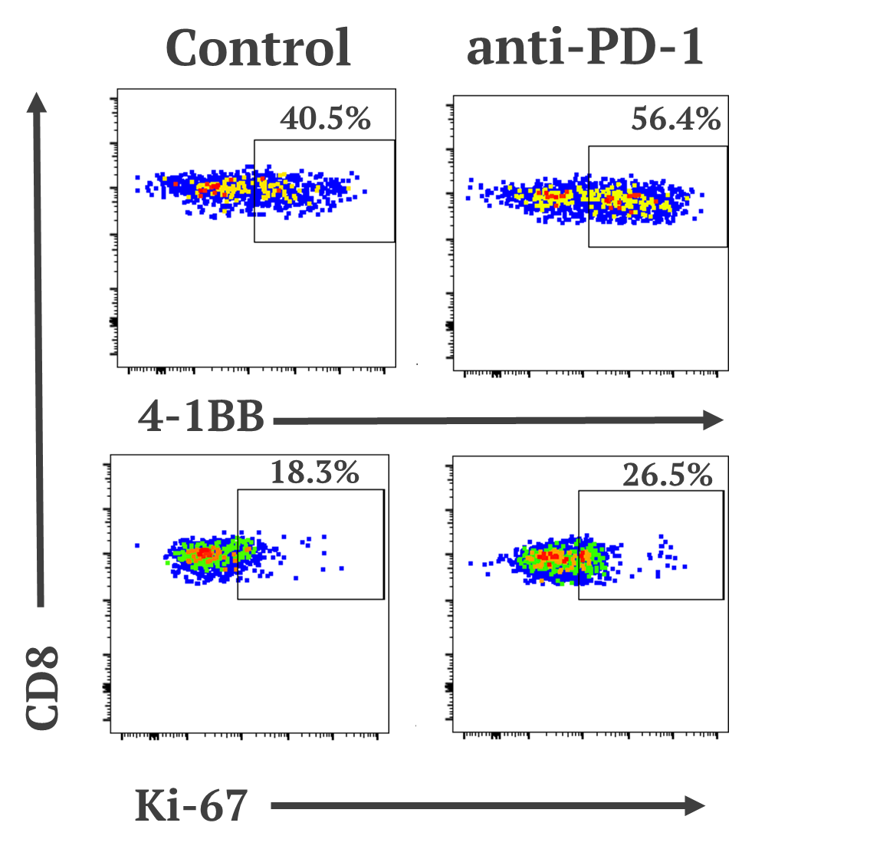
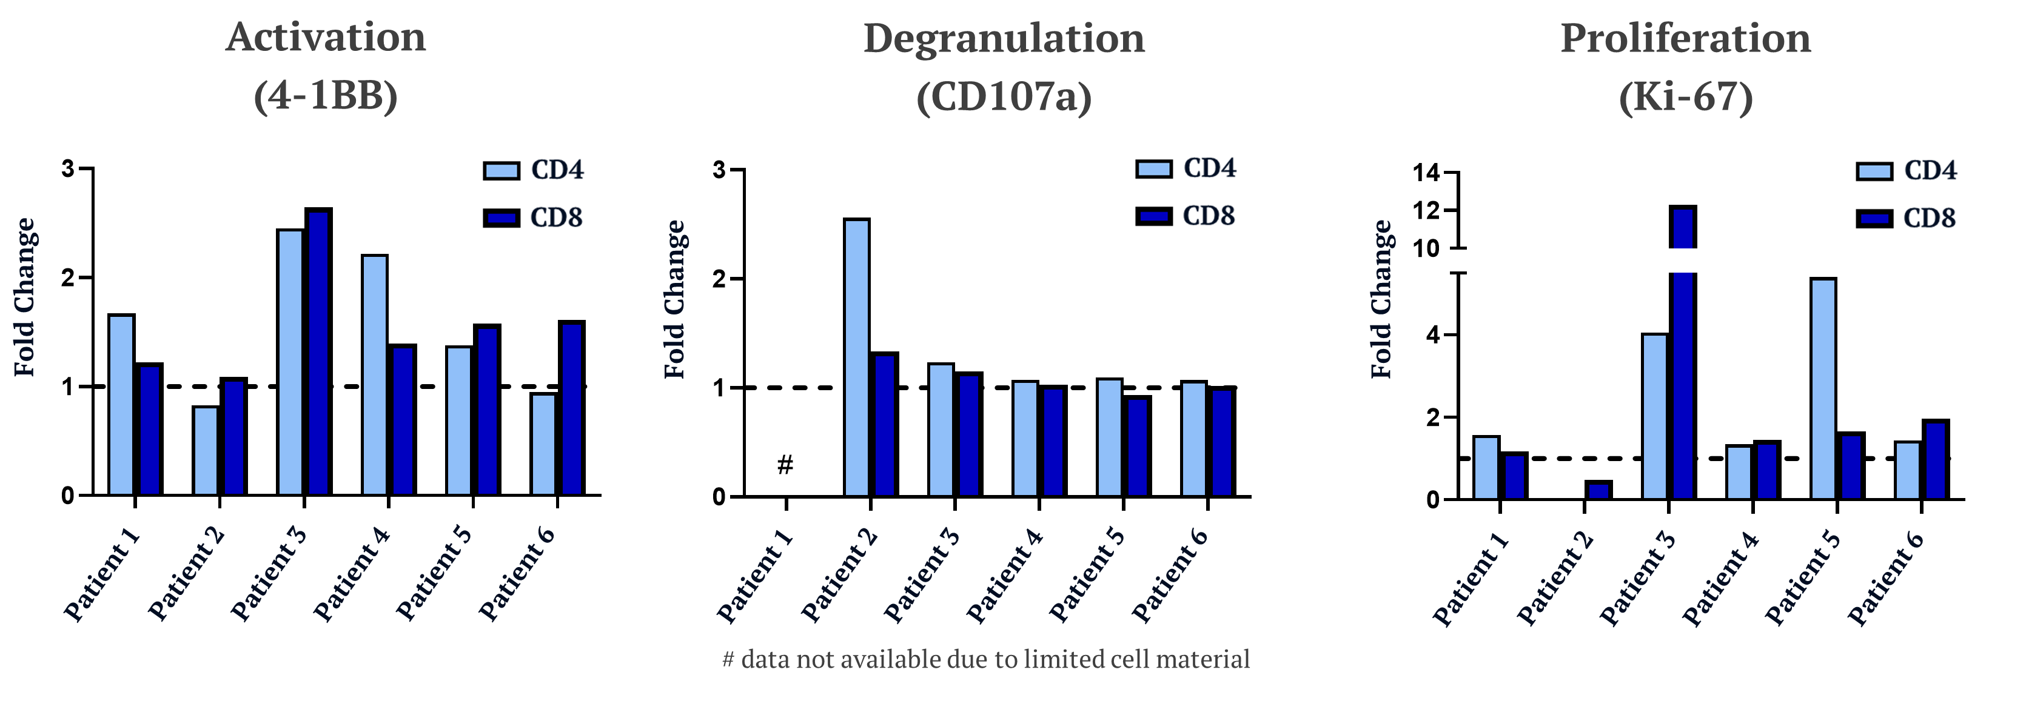
Reinvigoration with Checkpoint Inhibitors
A.
B.
A range of response is detected…No real trend for CD4 versus CD8
Suggests reinvigoration is patient specific and not a conserved response.
Degranulation was for the most part not altered in attempts to reinvigorate the TILs
Anti-PD-1 induced reinvigoration of ovarian patient TILs. (A) Representative flow cytometry plots of Patient 4 TILs from spheroids comparing negative control and anti-PD-1 after 48-72 hours. (B) TILs were evaluated for indicated markers and fold change was determined by normalizing percent of parent of anti-PD-1 treatment over the negative control.
Notes:
Patient 1: OVB32, Patient 2: OVB35, Patient 3: OVC17, Patient 4: OVC33, Patient 4: OVC42, Patient 6: OVD20

Slide 35
Utility – Bispecifics

Slide 36
General Bispecific Workflow
Identify tumor type(s) and screen for T-cells and Biomarker
Treat with multiple doses
Examine tumor cell death and T-cell activation
Flow Cytometry
Histology
Genomics
Flow Cytometry
Imaging
Cell Viability Readouts
Histology
Cytokine/chemokine expression
Controls can include, no T-cells, artificial activation of the T-cells, and control bispecifics

Slide 37
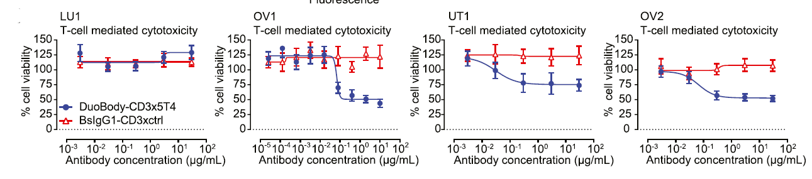
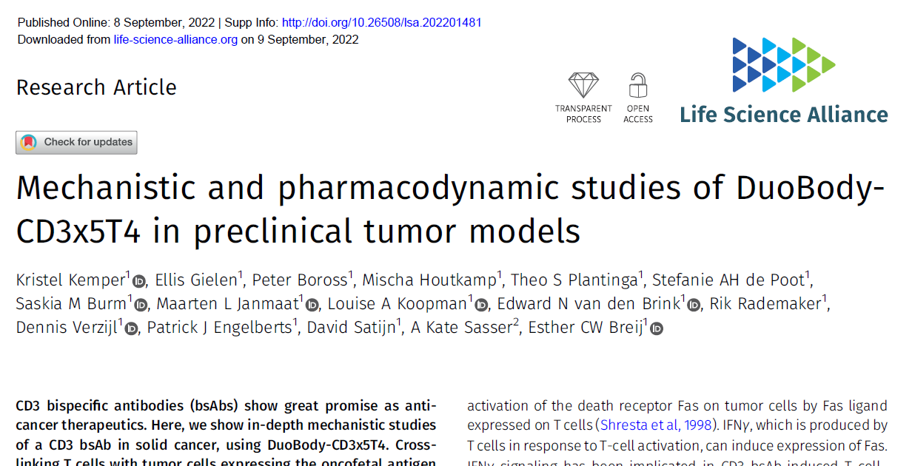
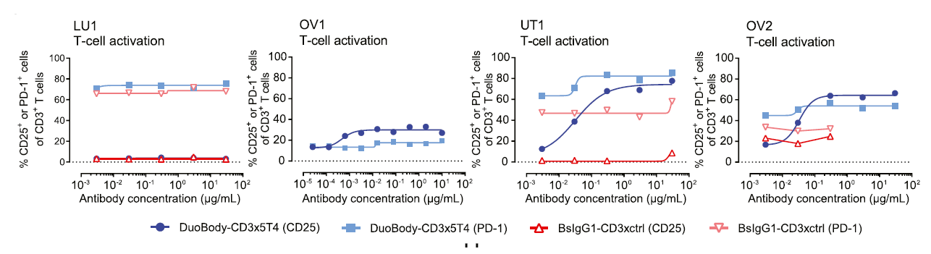
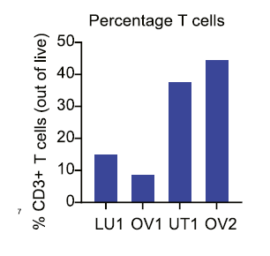
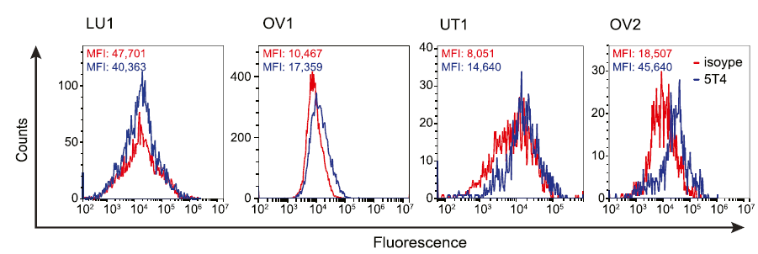
Bispecific antibody therapy induces T cell-mediated toxicity in patient-derived solid tumors
Individual tumors can be screened for T-cell content or other markers prior to use
Binding studies with bi-specific therapy or isotype controls can be performed on dissociated patient-derived solid tumor cells (CD45 − population).
37

Slide 38
Utility – Cellular Therapies

Slide 39
Cellular Therapies Can be Tested for Both Persistence and Tumor Cell Death
Adoptive Cell Therapies
Adoptive Cell Therapies
Tumor infiltrated lymphocytes (TILs)
CAR-T cell candidate selection
Autologous
expanded TILs
CAR-T
candidate #1
CAR-T
candidate #2
Bulk tumor
+
+
Do TILs induce anti-tumor cell activity?
Bulk tumor
Screen different CAR-T cell products to select the most cytotoxic and persistent in a patient-specific manner
Persistence?
Increased tumor burden assay
Repetitive antigen exposure assay

Slide 40
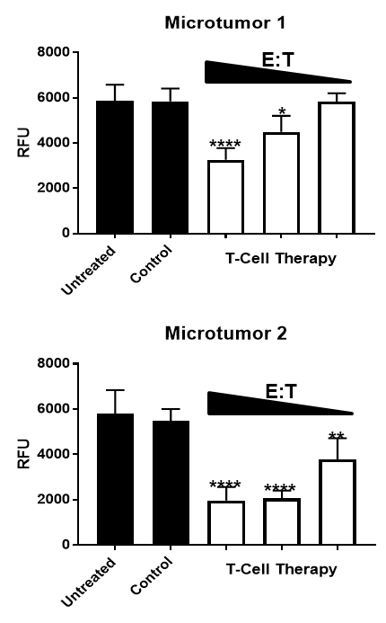
Cellular Therapies Can be Tested for Both Persistence and Tumor Cell Death
Dose Dependent Tumor Cell Death
Adoptive Cell Therapies
Adoptive Cell Therapies
Tumor infiltrated lymphocytes (TILs)
CAR-T cell candidate selection
Autologous
expanded TILs
CAR-T
candidate #1
CAR-T
candidate #2
Bulk tumor
+
+
Do TILs induce anti-tumor cell activity?
Bulk tumor
Screen different CAR-T cell products to select the most cytotoxic and persistent in a patient-specific manner
Persistence?
Increased tumor burden assay
Repetitive antigen exposure assay

Slide 41
KIYA-PREDICT™ platform offers utility along the drug discovery process
Target Validation / Lead-Op
Candidate Selection
Preclinical Development
Clinical Validation
Discovery
Target analysis
Cell / component analysis
Whole tumor analysis
2D / 3D cell profile
3D spheroid screen with multiple drugs and customized readouts
Combination studies
Target confirmation
Indication specific drug efficacy
Routine efficacy screening
Cell type validation / ex vivo microtumor analysis
In vivo model selection
Efficacy readout on a translationally accurate model
Triage final candidates
Companion diagnostics during trials
Phenotypic response
Patient selection
Trials response outcomes
Generation of ex vivo human models for future studies

Slide 42



Thank you for your attention!

